Slide 1

Muslimpreneurs: Empowering Youth in Business & Leadership
Information Session for Parents and Interested Students
Oct 8th 2025

Slide 2
Why Entrepreneurship & Leadership?

Slide 3

Core Program Objectives
Cultivate an Entrepreneurial Mindset: Ground students in innovation, purpose, and a sense of responsibility as community contributors.
Develop Leadership Skills: Provide real-world leadership training that prepares students for future challenges.
Teach Core Business Skills: Cover fundamental topics like budgeting, marketing, and execution through a practical lens.
Facilitate Hands-on Projects: Engage in real-world case studies and practical projects to apply learned knowledge immediately.
Build a Support Network: Benefit from team-based learning and invaluable mentorship from experienced professionals.

Slide 4
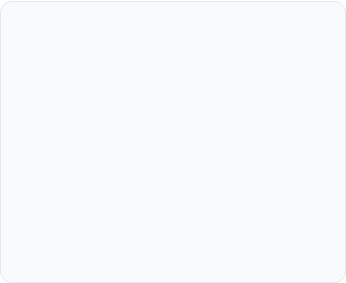
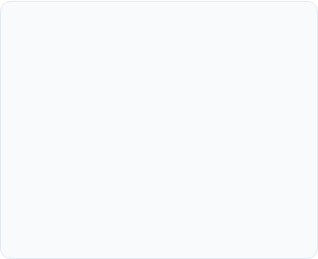
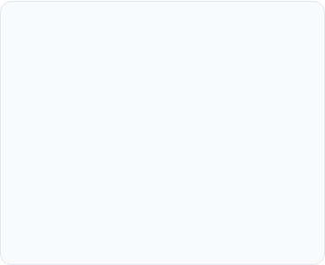
The Three Pillars of the Program
Entrepreneurial Mindset
Core Business Skills
Hands-on Business Projects
Fostering innovation, developing purpose-driven ideas, and building the confidence to pursue them.
Practical instruction on budgeting, market validation, effective marketing, and project execution.
Students apply their knowledge through real-world case studies and a capstone project.

Slide 5
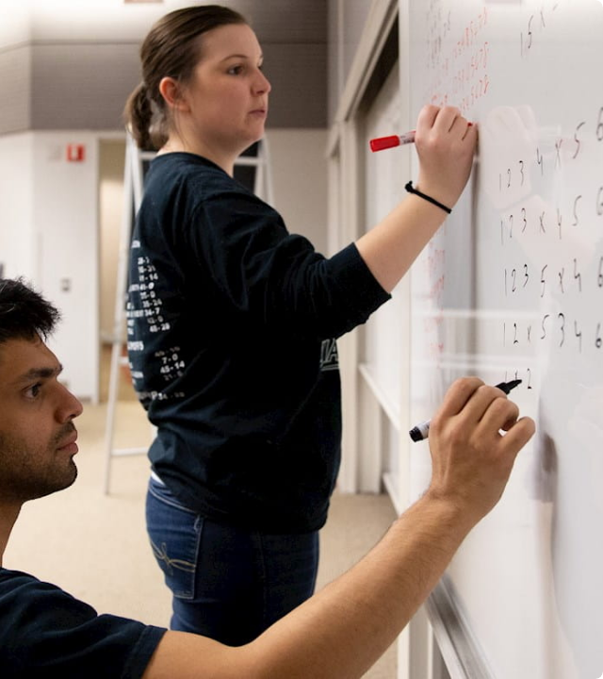
Who Should Join?
The Muslimpreneurs program is specifically designed for:
•
High School Juniors and Seniors (Grades 11–12)
•
Students focused on skill-building and creativity
•
Those interested in team collaboration and real-world application
The program emphasizes a team-based learning approach, with all projects guided by professional mentors.

Slide 6
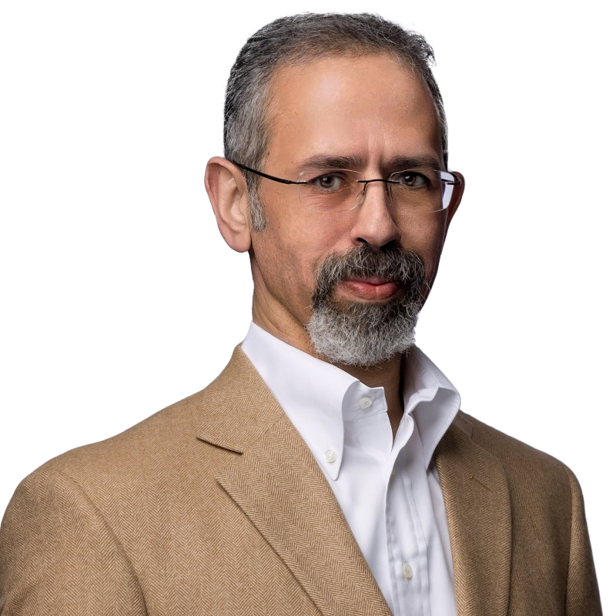
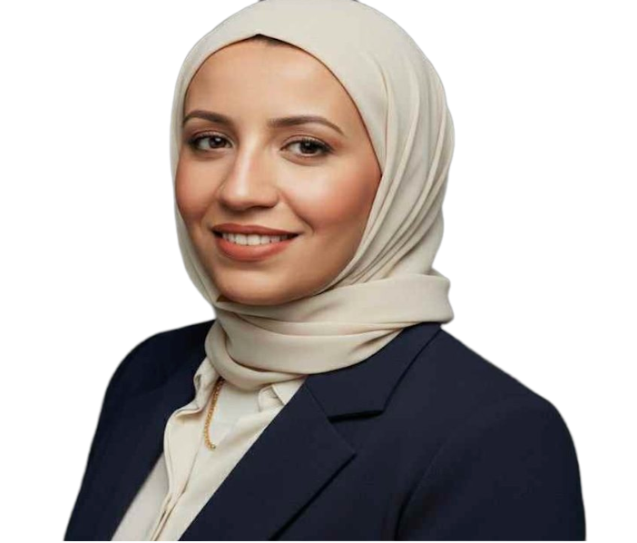
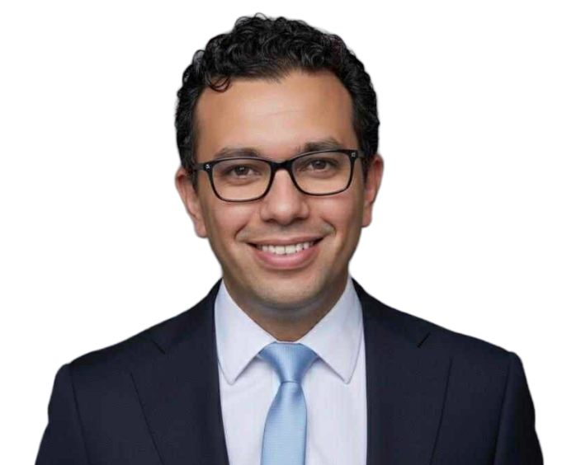
Meet the Program Team
Khaled Sedky
Yasmin Mowafy
Mahmoud Bishr
Khaled is VP of Engineering at Dropbox, leading a $2.5B portfolio. Formerly GM and VP at VMware Tanzu ($1.2B), he drove cloud-native strategy. With senior leadership roles at AWS and Microsoft, he’s shaped global tech platforms.Khaled has filed over 90 patents, with 60+ published, and holds a master’s in Computer Science from the University of Washington.
Product and Technology Leader currently serving at Google, where she drives the Monetization strategy for Compute and AI . With 15 years of experience, including senior roles at The Walt Disney Company where she successfully launched products focused on personalization and identity.
Spent his career building products and solving problems at leading tech companies including Amazon and Lime. He holds an MBA from Carnegie Mellon University and a bachelor in Computer Science. Mahmoud is passionate about mentoring youth and helping them turn ideas into practical, impactful ventures.

Slide 7
Comprehensive 12-Session Curriculum (Part 1)
1- Foundations of Entrepreneurship: Defining entrepreneurship and its ethical framework.
2- Opportunity Recognition: Identifying market needs and evaluating viability.
3- Business Model Development: Creating sustainable and scalable models (e.g., Lean Canvas).
4- Market Validation & Customer Development: Understanding target audiences and conducting effective validation.
5- Business Planning: Formalizing strategy, operations, and resource allocation.
6- Financing and Investment: Basic financial literacy, budgeting, and funding sources.
7- Building and Leading Teams: The fundamentals of team dynamics, delegation, and leadership.
8- Growth and Scaling: Strategies for sustainable business expansion.
9- Social Entrepreneurship & Ethics: Integrating purpose and ethical decision-making into business.

Slide 8
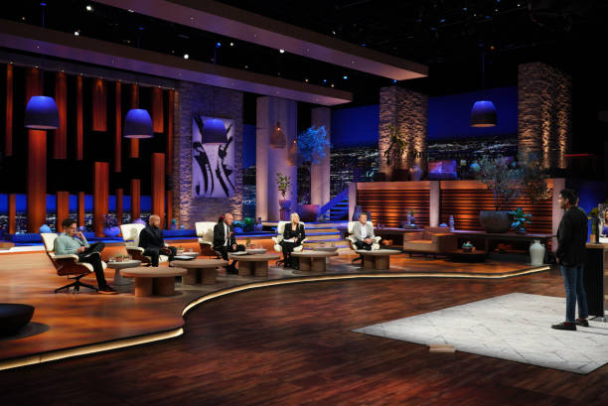
Curriculum (Part 2): Muslim Shark Tank
Practical Project (Last 4 Sessions): A hands-on final project where students develop and pitch their own business idea.
Mentorship program with local business community
Business plan development
Mock investor pitch sessions

Slide 9
Program Logistics: When and Where
Item | Details | Notes
Duration | 12 Sessions | October 2025 to February 2026
Format | In-Person | Medina Academy Redmond (12 in person sessions)
Schedule | Sundays | 12:00 PM – 1:30 PM
Program Fee | $300 | Includes materials and mentorship access

Slide 10

Program Milestones: A 5-Month Journey
Oct '25
Jan ‘26 - Feb '26
Orientation & Team Formation
Project & Final Showcase
(Demo Day)
Sep-Oct '25
Oct '25 - Dec '26
Recruitment & Applications
Weekly Program Sessions

Slide 11
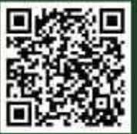
Questions & Next Steps
Thank you for your interest in the Muslimpreneurs program. We are now open for question!.
Register Now: medinaacademy.org/musp
Contact: mp@medinaacademy.org

